Slide 1
JS
LOCAL STORAGE
JSON

Slide 2

OBJECTIVES
What is the Local Storage ?
How to use it ?
Understand the JSON format

Slide 3


Browsers allow you to save
Up to 10 Mb of data locally
LOCAL STORAGE
WRITE
READ

Slide 4
The local storage is a dictionary
local Storage = { key: value, key: value,… }
WRITE
READ

Slide 5
Set a value
localStorage.setItem("amount", 12);
GLOBAL
VARIABLE
KEY
VALUE
Get a value
let amount = localStorage.setItem("amount");
KEY

Slide 6
Clear all
localStorage.clear();
Clear only 1 item
localStorage.removeItem("amount");
KEY

Slide 7
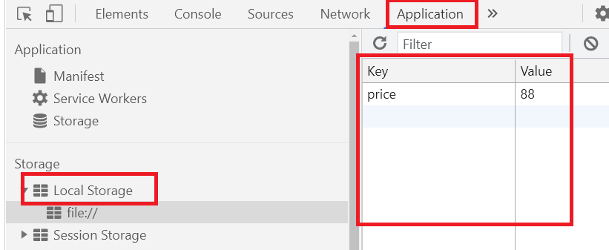
How to see your local storage in Chrome ?
DEMO

Slide 8

PRACTICE
ACTIVITY 1
15 MIN
Complete the code of activity 1

Slide 9


What the value restored is not
the same on different browsers?
Notes:
Local storage is specific to each browser

Slide 10
PRACTICE
ACTIVITY 2
15 MIN
Can we store an object in local storage ?
let name = nameInput.value;
let color = colorInput.value;
let animal = { name: name, color: color };
localStorage.setItem("animal", animal);
Run the code and see what you get from Local storage

Slide 11


"[object Object]"
How do we solve this ?
let animal = { name: “fish”, color: “blue” };
JSON.stringify(animal)
JSON.parse(storageValue)
{ name: “fish”, color: “blue” };

Slide 12
PRACTICE
ACTIVITY 3
15 MIN
Fix the bug of activity 2

Slide 13
PRACTICE
ACTIVITY 4
15 MIN
Complete the CITIES APP to save/restore

